Slide 1
2017 Conversationalists
20th Annual
Table Talk Luncheon
Presented by the
University of Houston
Friends of Women’s Studies

Slide 2
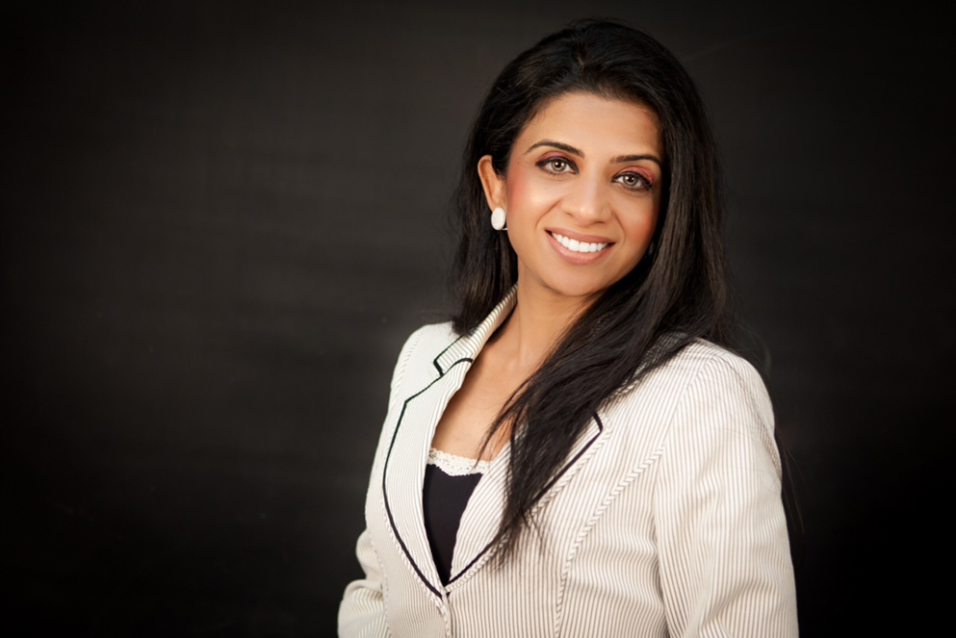
Farida Abjani
CEO, Shining Nightingale

Slide 3
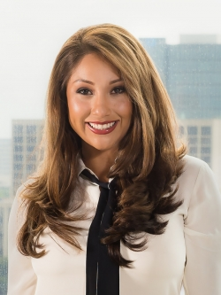
Nancy Almodovar
CEO/President, Nan & Company Properties

Slide 4
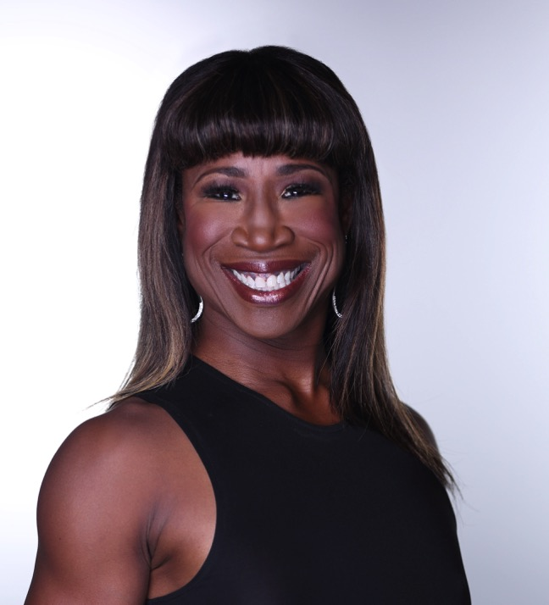
Lauren Anderson
Program Manager, ECE, & Former Principal Dancer, Houston Ballet

Slide 5
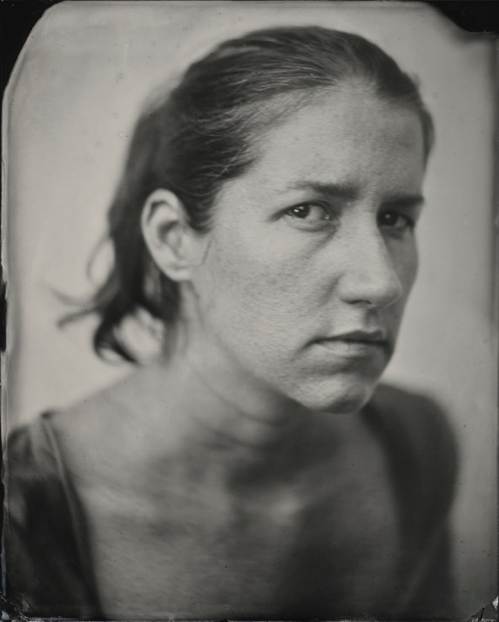
Keliy Anderson-Staley
Assistant Professor of Photography/Digital Media,
UH School of Art

Slide 6
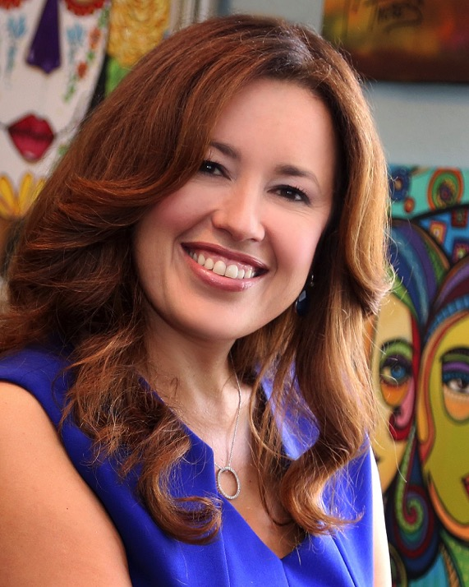
Nory Angel
Executive Director & CEO, SER-Jobs for Progress

Slide 7
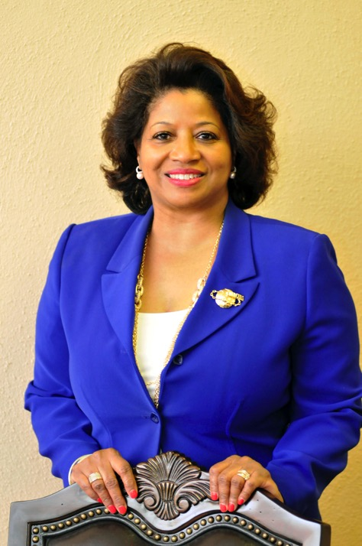
Rhonda C. Arnold
Chief Municipal Affairs Officer, Houston Airports

Slide 8
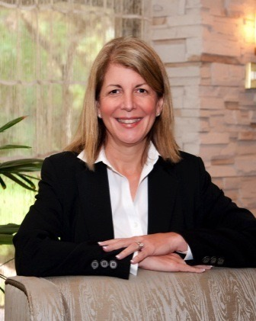
Decie Autin
Vice President, Project Management & Execution, ExxonMobil Development Company

Slide 9
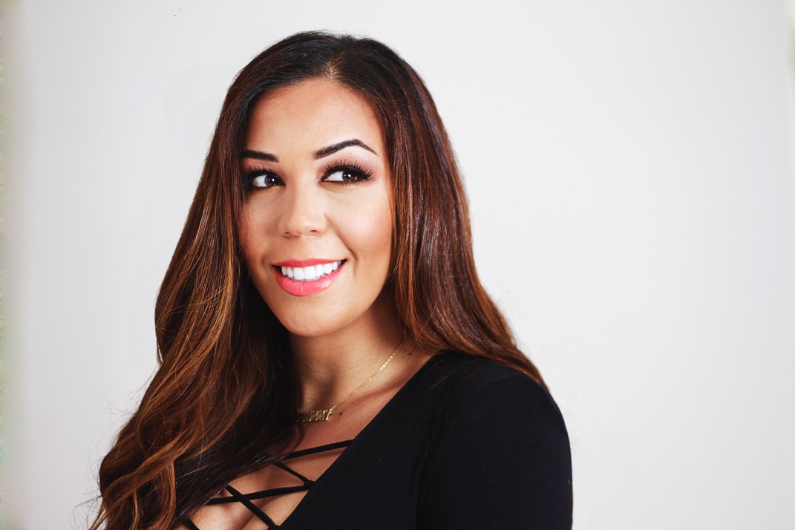
Devi Brown
Radio Personality, iHeartmedia; CEO, Karma Bliss

Slide 10
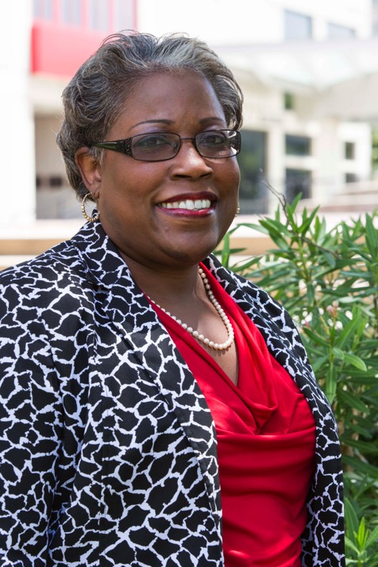
Marcilynn Burke
Associate Dean & Associate Professor of Law,
UH Law Center

Slide 11
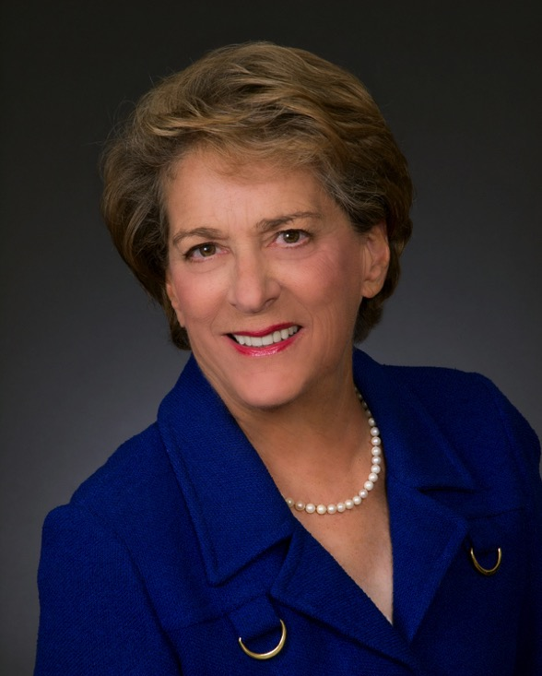
Ellen Cohen
Councilwoman, Houston City Council, and Mayor Pro Tem

Slide 12
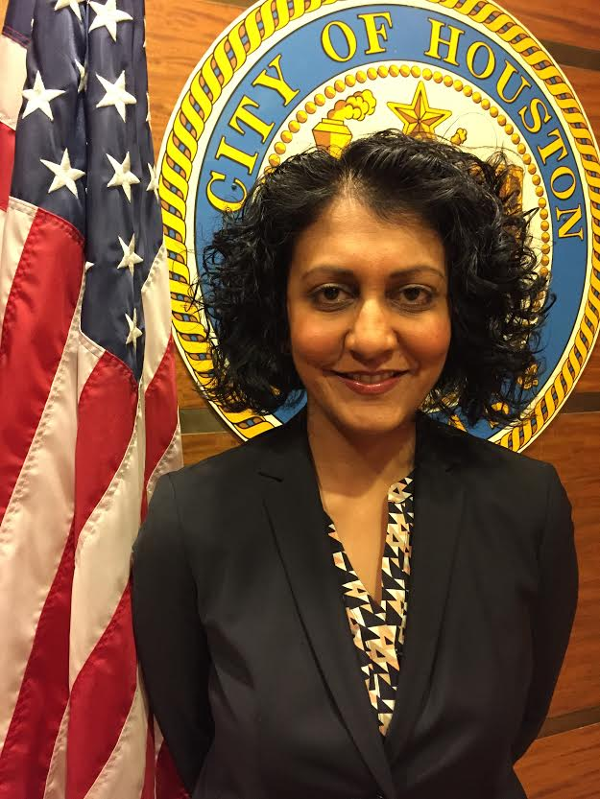
Minal Patel Davis
Special Advisor to the Mayor on Human Trafficking,
City of Houston

Slide 13
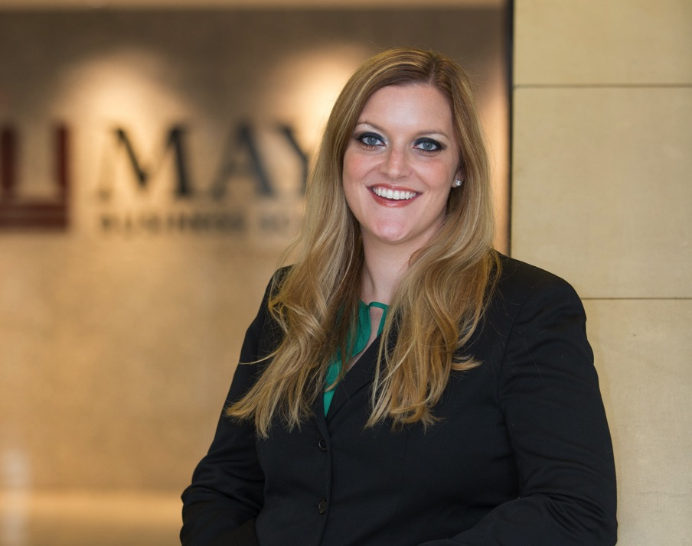
Shannon Deer
Director, Full-Time MBA Program & Accounting Faculty,
Texas A&M University

Slide 14
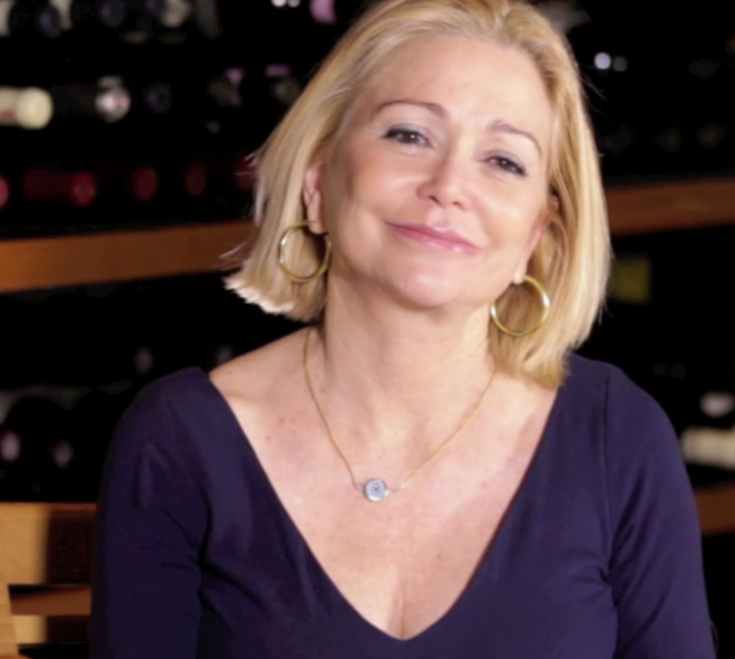
Mimi Del Grande
Co-Owner, Café Annie

Slide 15
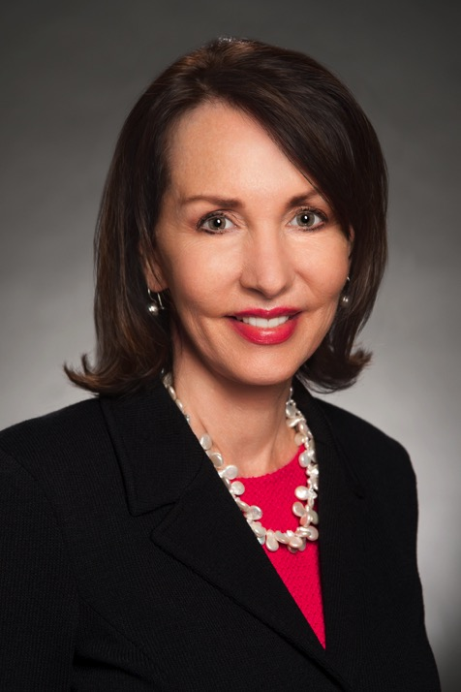
Susie Distefano
Senior Vice President & CEO,
Children’s Memorial Hermann Hospital

Slide 16
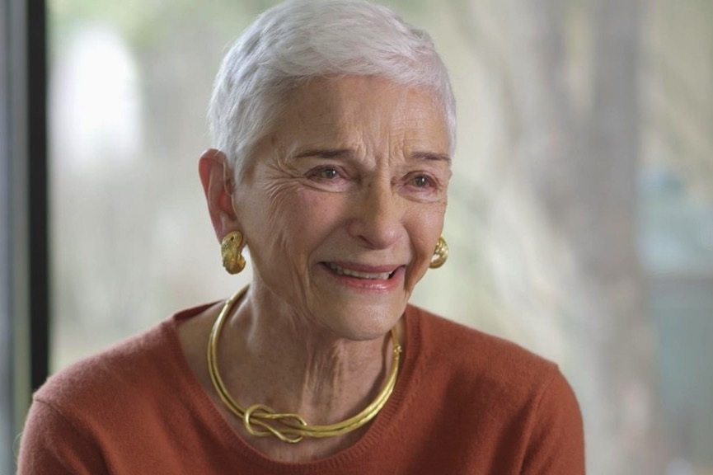
Sissy Farenthold
Activist

Slide 17
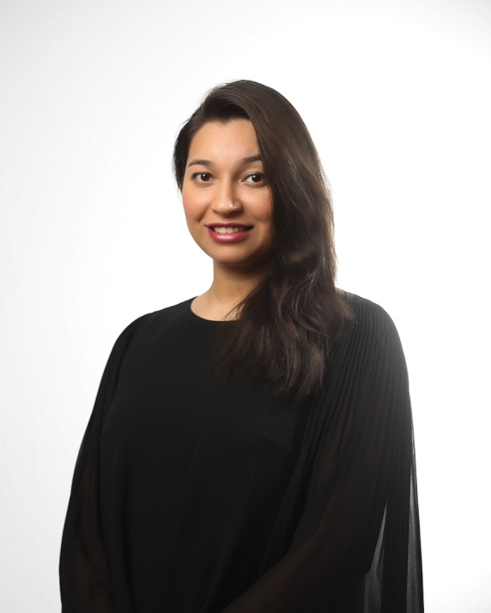
Sameera Faridi
Director/Designer, Poshak Fashion & Style

Slide 18
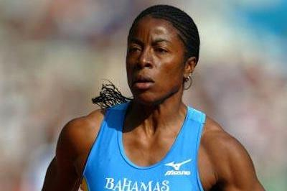
Debbie Ferguson-McKenzie,
UH Women’s Track & Field Coach, 3-time Olympic Medalist

Slide 19
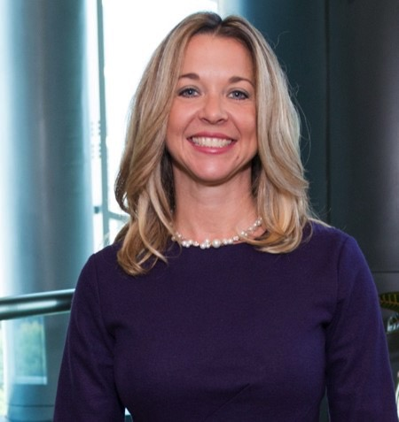
Julie Baker Finck, PhD
President, Barbara Bush Houston Literacy Foundation

Slide 20
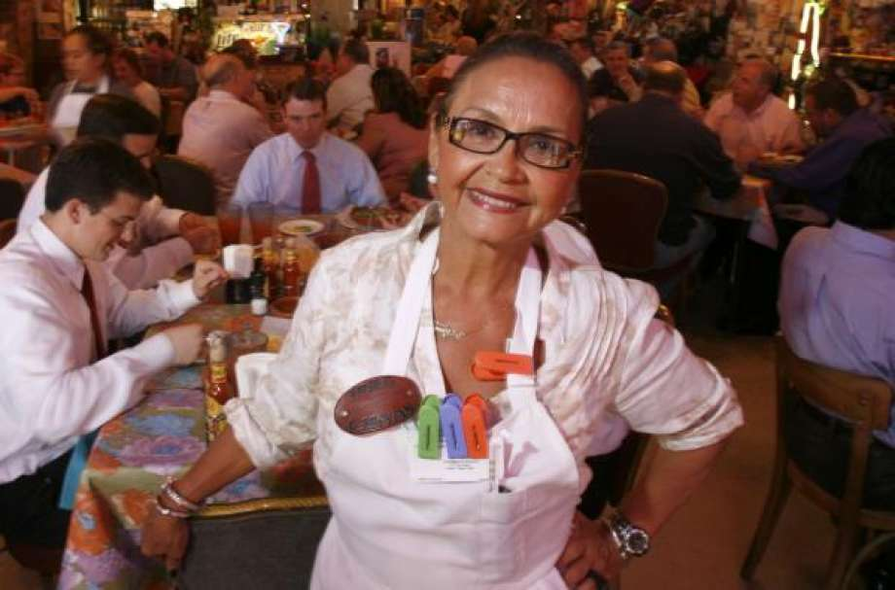
Irma Galvan
Owner/Chef, Irma’s Restaurant

Slide 21
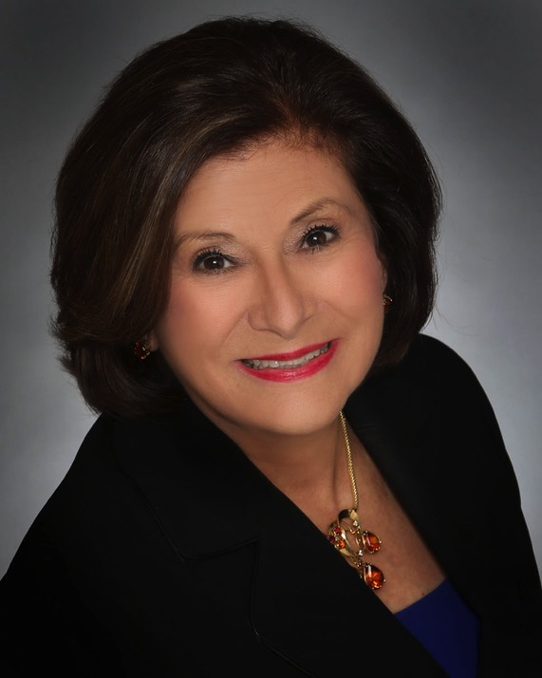
Beatrice Garza
Former President/CEO, Association for the Advancement of Mexican Americans , Inc.

Slide 22
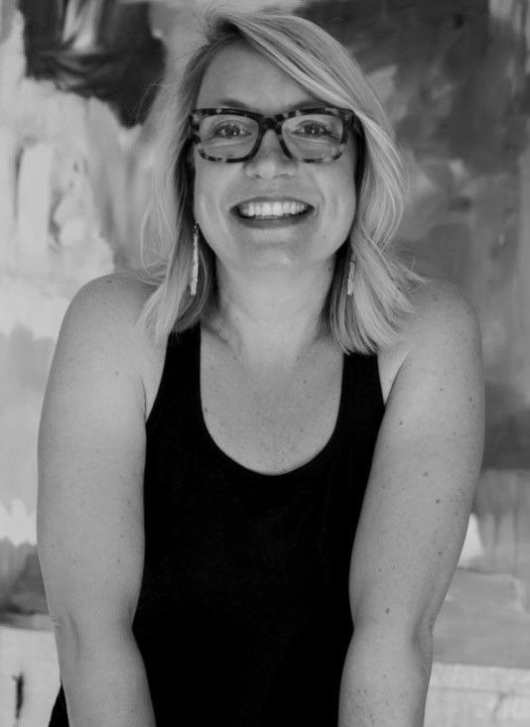
Leslie Gaworecki
Table Talk 2017 Featured Artist

Slide 23

Winell Herron
Group Vice President of Public Affairs, Diversity,
& Environmental Affairs, H-E-B

Slide 24
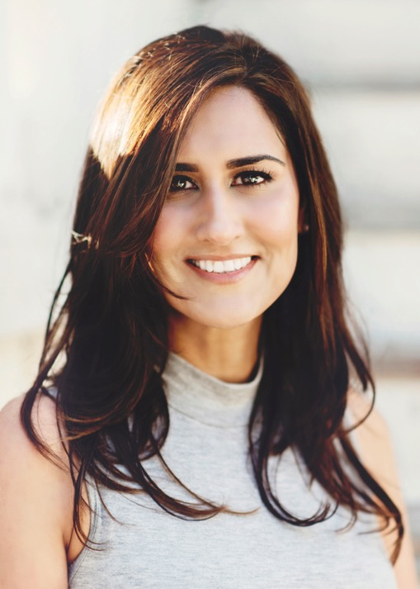
Shezi Kirmani, MD
Medical Director, My Pure MD, PLLC

Slide 25
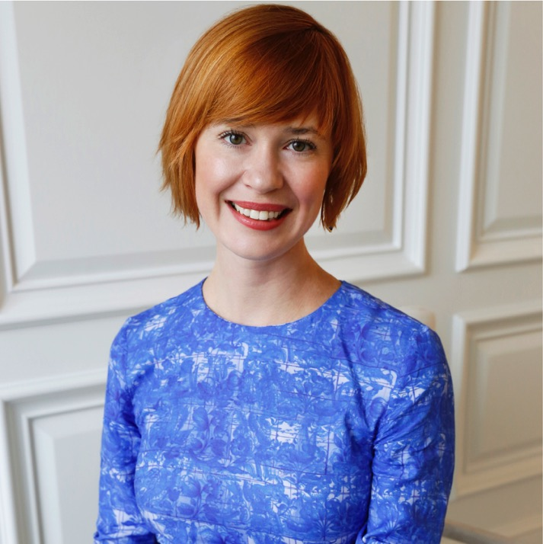
Cheryl Mills Knight
Brand Director, Kendra Scott Jewelry

Slide 26
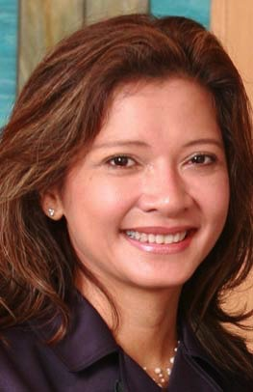
Bonna Kol
President, Asia Society

Slide 27
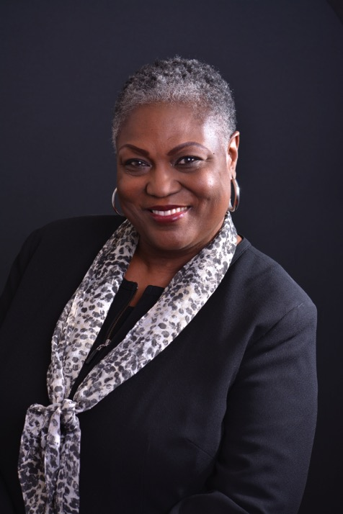
Rhea Lawson
Director, Houston Public Library

Slide 28
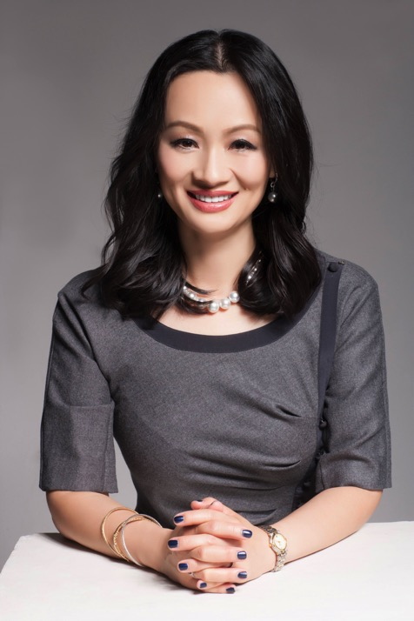
Bridgette Shen Lee, OD
Owner, Vision Optique

Slide 29
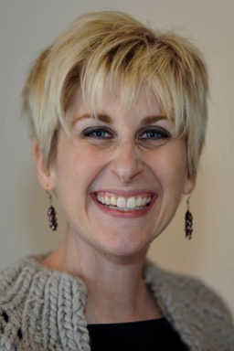
Nicole Longnecker
Owner, Nicole Longnecker Gallery

Slide 30
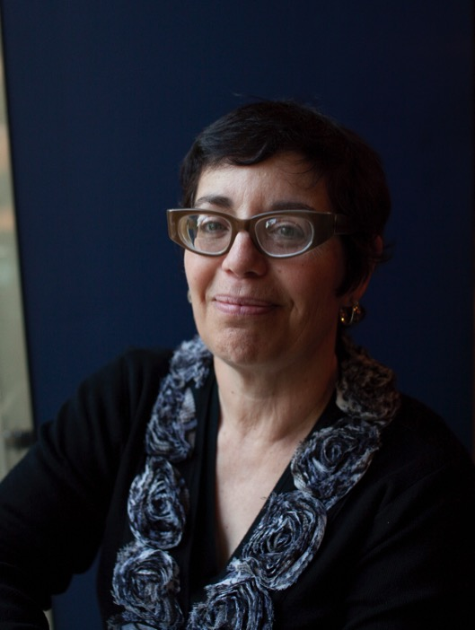
Marian Luntz
Curator, Film and Video,
MFAH

Slide 31
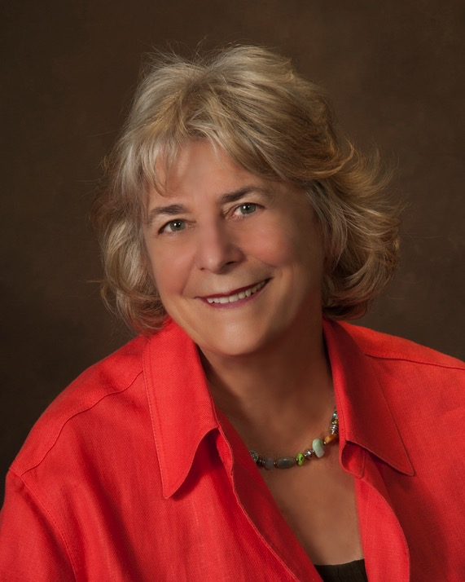
Ann MacNaughton
Wealth Management Advisor, Merrill Lynch

Slide 32
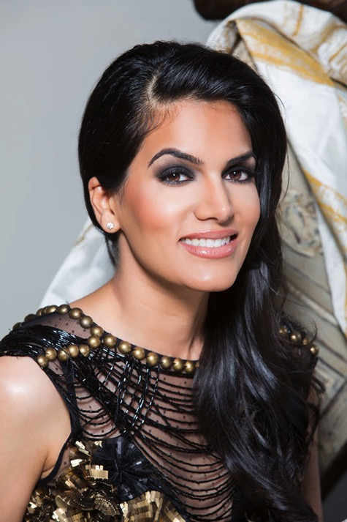
Nina Magon
Creative Director/Principal, Contour Interior Design

Slide 33
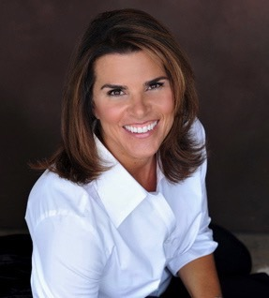
Lisa Malosky
Sports Journalist; CEO, LisaMaloskyProductions

Slide 34
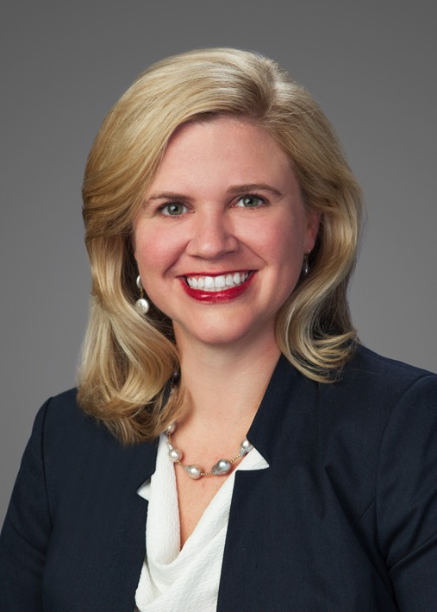
Ashley McClellan
CEO, The Woman’s Hospital of Texas

Slide 35
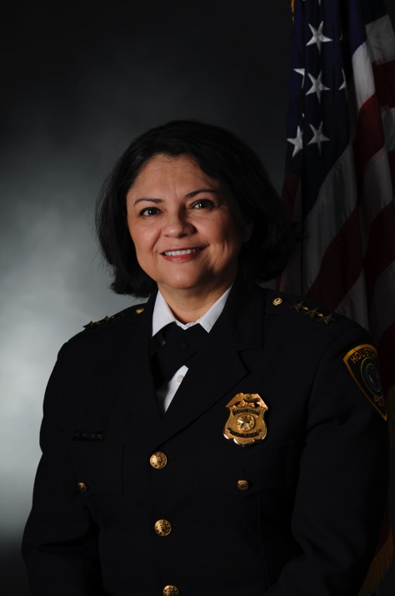
Martha Montalvo
Executive Assistant Chief/Former Interim Chief,
Houston Police Department

Slide 36
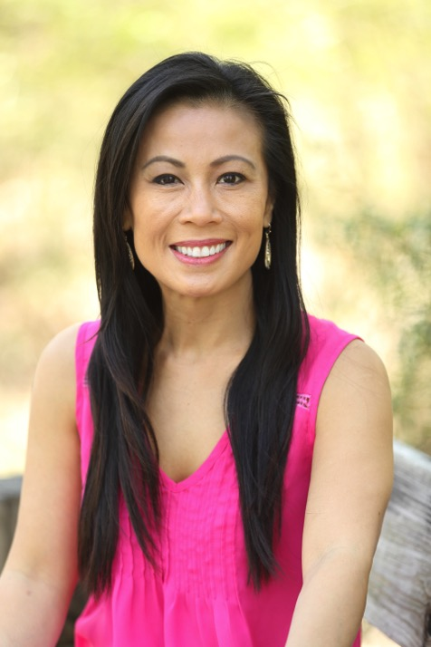
Chau Nguyen
Chief Marketing Officer, Houston Area Women’s Center

Slide 37
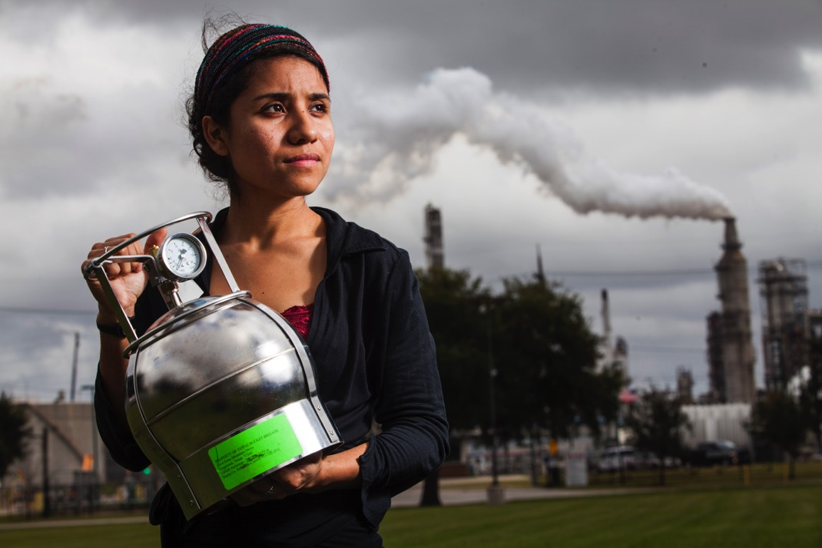
Yudith Nieto
Community Advocate, Texas Environmental Justice Advocacy Services (T.E.J.A.S.)

Slide 38
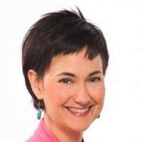
Linda Flores Olson
Executive Director, Houston Hispanic Forum

Slide 39
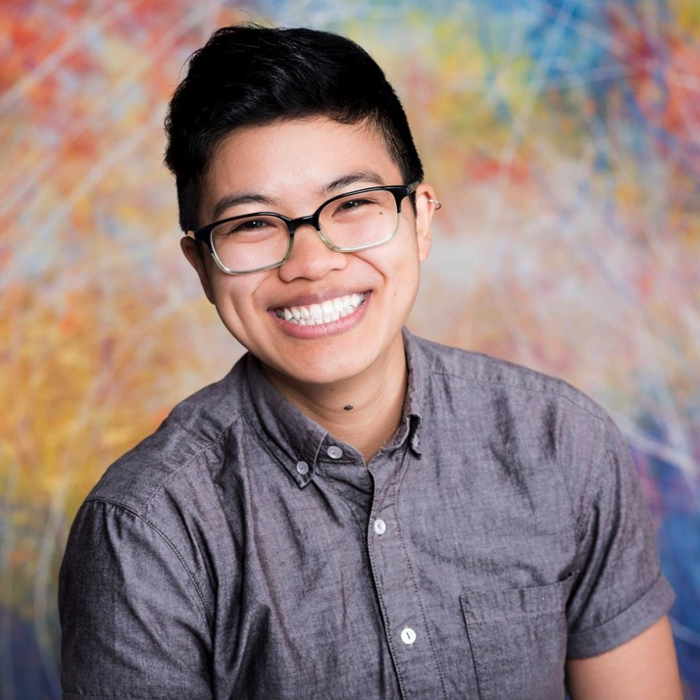
Melanie Espinosa Pang
Co-Chair, Mayor’s LGBTQ Advisory Board; Qualitative Research & Evaluation Manager, The Salvation Army

Slide 40
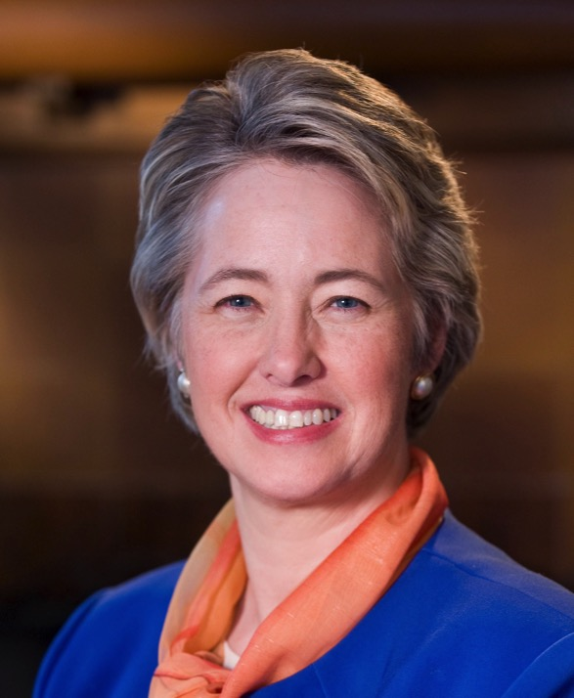
Annise Parker
Former Houston Mayor; SVP &
Chief Strategy Officer, Neighborhood Centers Inc.

Slide 41

Carrin Patman
Board Chair, Houston METRO

Slide 42
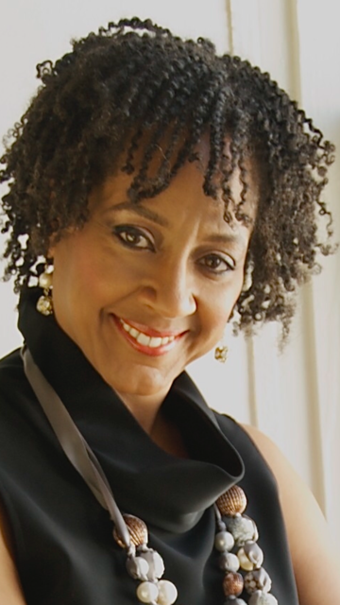
Juanita Rasmus
Pastor, St. John’s United Methodist Church

Slide 43
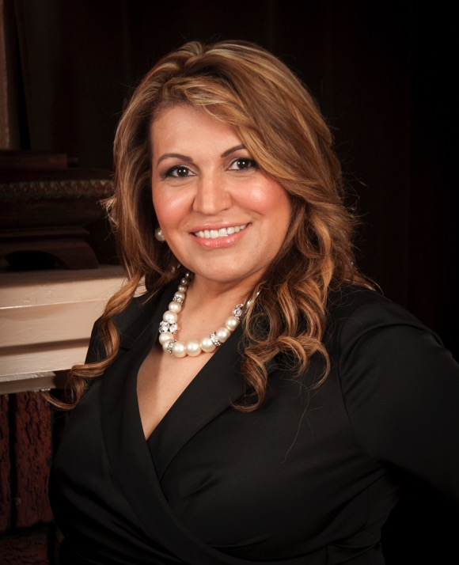
Maria Rios
Founder/President/CEO, Nation Waste, Inc.

Slide 44
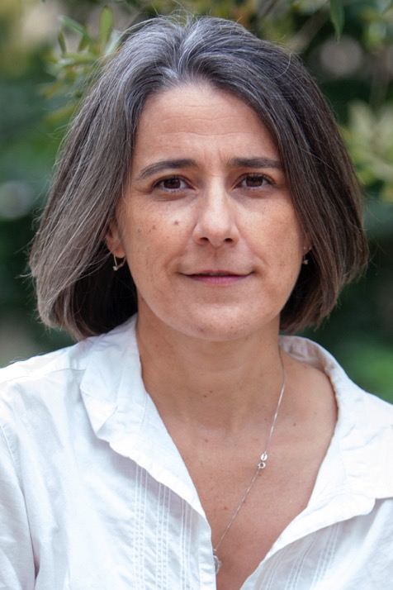
Dr. Martha Serpas,
Poet, author of The Diener;
Professor of English, University of Houston

Slide 45
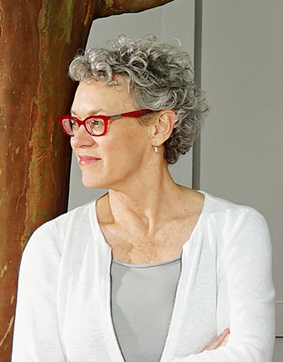
Carrie Shoemake
Founding Partner, GSMA Architects, Inc.

Slide 46
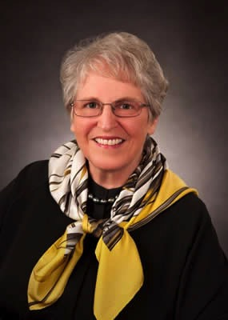
Carey Shuart
Owner, Shuart Farms; Activist,
Shuart Women’s Archive & Research Collection, UH

Slide 47

Deepi Sidhu
Broadcast Journalist & Texans Insider, Houston Texans

Slide 48
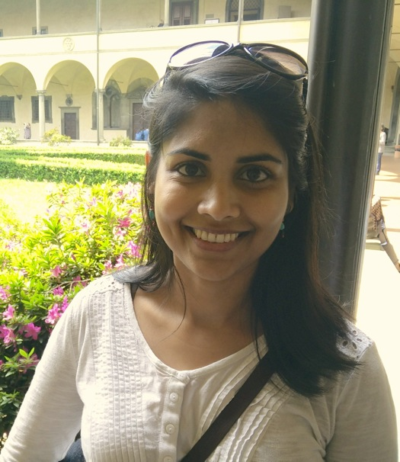
Kavita Singh, PhD
Assistant Professor of English/Caribbean Studies

Slide 49
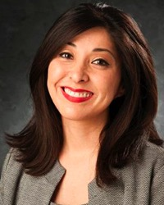
Juliet Stipeche
Director of Education, City of Houston

Slide 50
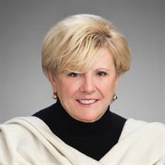
Paula Sutton
Chairman of the Board, Interfaith Ministries for Greater Houston

Slide 51
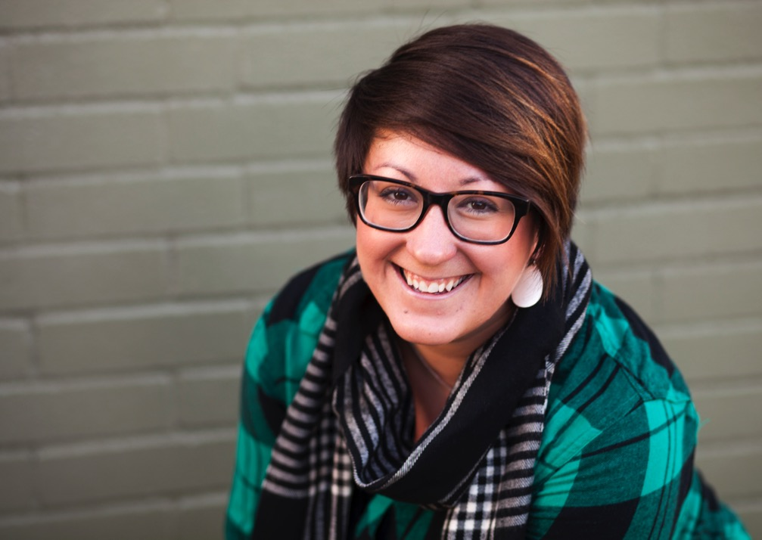
Hannah Terry
Associate Pastor, Fondren Apartment Ministry, Westbury United Methodist Church

Slide 52
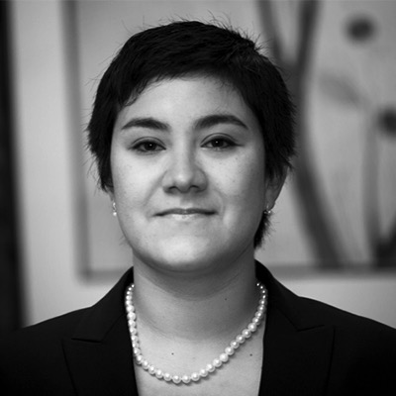
Frances Valdez
Owner, FValdezLaw PC

Slide 53

Amitha Verma
CEO, Amitha Verma Home Decor

Slide 54
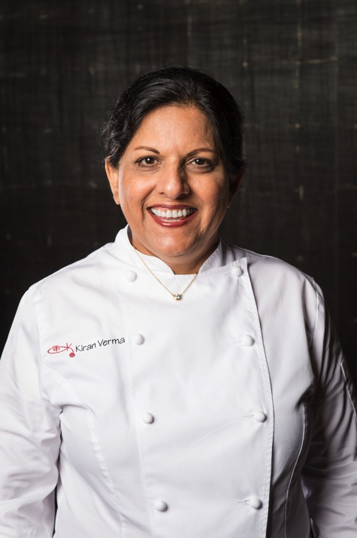
Kiran Verma
Executive Chef/Owner, Kiran’s Restaurant

Slide 55
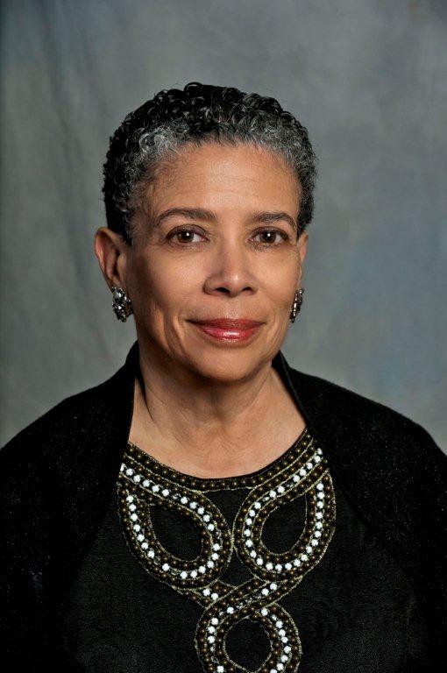
Dr. Alvia Wardlaw,
Director/Curator, University Museum,
Texas Southern University

Slide 56

Beth White
President/CEO, Houston Parks Board

Slide 57

Andrea White
Editorial Board, Houston Chronicle

Slide 58

Dawniel Winningham
President/CEO, Wealthy Sisters Network

Slide 59

Aimee Woodall
Executive Director, The Black Sheep Agency

Slide 60

Lynn Wyatt
Philanthropist

Slide 61

Kelly Zúñiga
CEO, Holocaust Museum Houston

